Slide 1

DevOps Transformation for Mainframes
Presented to Ameriprise
On
29/May/2019

Slide 2
Agenda
Mainframe DevOps – Why and How ?
Mainframes DevOps – People, Process and Tools
Ameriprise Devops Journey – Recap
What next to achieve complete DevOps transformation ?

Slide 3
DevOps on Mainframes – Why and How?

Slide 4
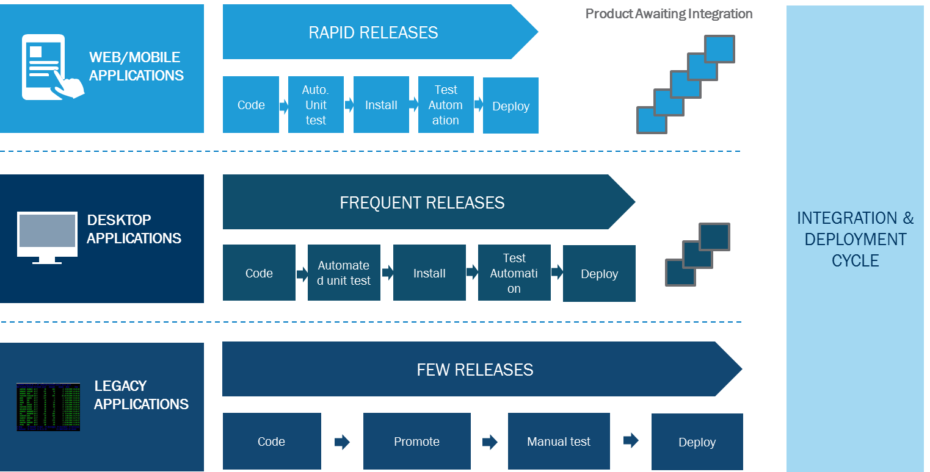
Enterprise agility – “you are only as fast as your slowest link”

Slide 5
Factors affecting enterprise agility
03
02
Largely manual testing, integration and deploy
Limited environments and interdependencies
Dependency on external systems limits ability to test early
Lack of consolidated view of a project across life cycles and teams
Longer cycles & Fewer Releases
01
01
PEOPLE
Heavy governance and controls
Largely waterfall execution of projects
Exhaustive documentation & sign-offs
Handshake between development, QA and operations not collaborative
ENGINEERING PRACTICES
PROCESSES
02
Transition from Dev to Ops slow & ineffective
Due to the nature of engagements, dev & ops across projects/LOBs work in silos
Waterfall way of working that limits the time to react
Limited expertise on agile devops across teams
03

Slide 6
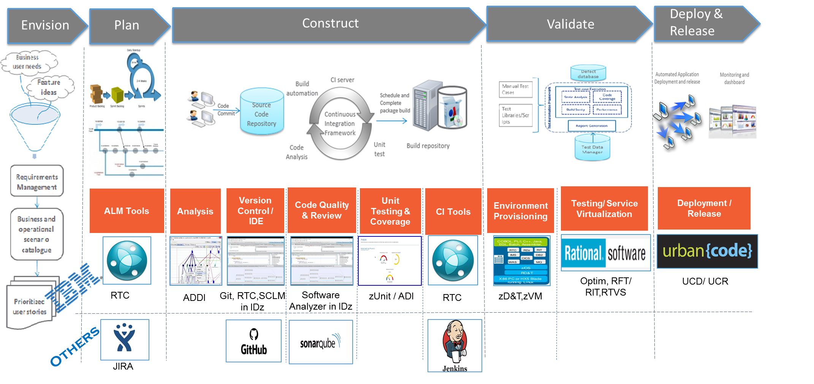
DevOps “Tools” – Solution to Developmental Challenges

Slide 7
The Ameriprise DevOps Journey – Re-cap

Slide 8
Mainframe DevOps at Ameriprise
Available features of RDz and RTC are not fully utilized
Lack of end-to-end Continuous Integration & Continuous Delivery pipeline for mainframe technology build
Manual code reviews, Manual unit and code coverage testing, No automation in functional and regression testing
Manual Unit, System and Integration Testing
Agile is not yet in practice across the projects
Current Limitations
Emphasize the usage of tools that can be leveraged for DevOps on the mainframe.
Increase RDz Adoption by integrating RDz and Changeman (Menu Manager).
Increase Coding and Unit Test Efficiency through software Analyzer and Topaz for total Test (XA Tester)
Explore other tools for Continuous Integration and Deployment/Delivery (eg. Jenkins, Urban Code Deploy)
Interactive workbench tools through HATS/RCP (Host Application Transformation Service/Rich Client Plugin)
What we plan to Achieve
Adoption of these tools helps in establishing DevOps pipeline and increases developer productivity resulting in long term cost benefits
The Average Cost Benefit of using XaTester is approximately ~235K per annum
Increased adoption of RDz, also opens up paths to many additional tools/plugins
Usage of State of the art Products in Mainframe Domain to enhance CICD pipeline
Faster software delivery
Benefits

Slide 9
DevOps Journey thus far..
Accomplishments
Upcoming
In progress
Installation of Topaz for Total Test
Assessment of Application Discovery and Application Delivery Intelligence (ADDI) – pending closure, CBA and recommendation.
Assessment of Jenkins as Mainframe CICD pipeline and SonarCOBOl for code quality check
PoC to evaluate Rational Application Developer (enables HATS/RCP) – on hold pending upgrade of RDz to IDz.
Proof Of Concept for Sonar COBOL and Jenkins
Strengthen CICD Pipeline by assessment of productions mentioned below:
JIRA for Project tracking
JENKINS/Urban Code Deploy for Continuous Delivery
Evaluate SonarCOBOL vs software analyzer in CI pipeline
Evaluate UCD (urban code Deploy for deployment
Explore other tools for mainframe modernization like z/OS Connect and zD&T
Proof of Concept for RDz Integration with Changeman was complete successfully
Initiative to integrate rest of the functionalities was taken up and overall 24 functionalities were integrated.
Organization wide demo for RDz changeman Integration.
Completed POC for Topaz for Total Test and procured 100 licenses

Slide 10
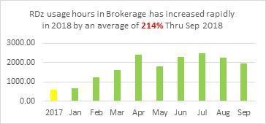
Benefits observed
RDz Changeman Integration : Assuming 60 developers use Changeman thrice a week, this integration saves $193,752 USD per year, by saving the toggling time between emulator and RDz
XATester : On an average 2500 components are tested each year. With this data, XaTester is expected to brings a cost save of around 253,815 USD per year
RAD/HATS : Assuming 60 developers use workbench features thrice a week, this integration is expected to save around $75,816 USD per year, by saving the toggling time between emulator and RDz
* Considering a chargeback of $54/hour
* Considering a chargeback of $54/hour
* Considering a chargeback of $54/hour
Notes:
RDz :
3 times a week
1 minute
100 Developers
23 functionalities
((23*1*2*60)/60) * 54 = 6210 USD for a week
966*52 = 50232 USD a year
XATester :
components, 2 hours per component save.
HATS/RAD :
3 times a week
1 minute
60 Developers
9 functionalities
((9*1*2*60)/60) * 54 = 2430 USD for a week
378*52 = 126360 USD a year

Slide 11
Upcoming PoCs
Mainframe
RDz/IDz
Jenkins
Triggered Build
TTT Functional Test
SonarQube
Quality analysis
EVENT
Changeman ZMF
Phase 1 | Phase 2 | Phase 3
Implementation and rollout for TTT Demonstrate the technical capabilities and usage of SonarCOBOL Establish a basic connection (CI) between mainframes, Jenkins, SonarCOBOL and Topaz for Total Test and showcase it for component staging process Menu manager enhancements The first phase of the PoC is estimated to be around 1800 hours. | This phase will involve evaluating possibilities of various component type, scenarios, application specific customization for Jenkins CI pipeline. | Evaluate and fix any gaps in the pipeline created in Phase 2 Evaluate additional tools which can be stitched in the pipeline for various phases like SIT, Deployment etc. This would aim towards creating complete CI-CD pipeline for mainframes

Slide 12
What’s NEXT to a Complete DevOps transformation?

Slide 13
Achieving complete DevOps transformation
People and Process
Integration tools/orchestrators/connectors
Developer workflow
Automated testing frame work
Continuous integration & deployment
Continuous monitoring & Feedback

Slide 14
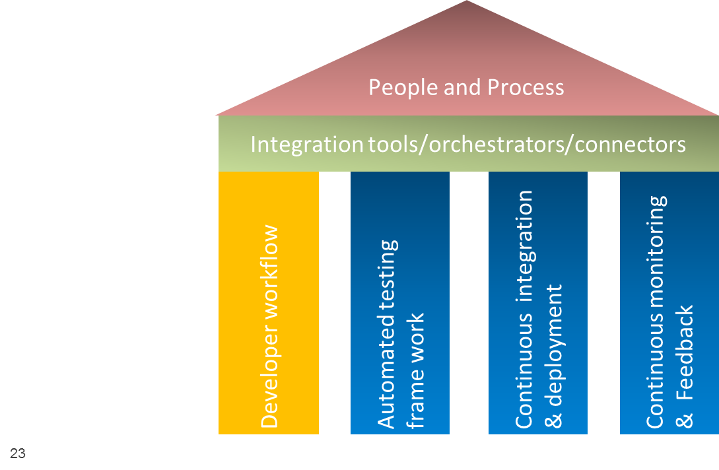


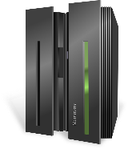
Developer workflow Stream
Developer
Jira
PoC Scope
Developer workstation – one click process from RDz
Code Check-Out
Development
Unit Testing +
Code Coverage
Code quality
Peer-review
Code check-in
1
Analysis
Mainframes
Changeman
Matured
Started
Not Started
SCM – Changeman is used for source code management
RDz – Is used for development
ADDI – Code and impact analysis tool
XA Tester/ TFT – Unit test testing and code coverage
Software Analyzer - is used for code quality and review, SonarLint to be explored in PoC
Smartbear Collaborator –Peer review process
Jira – Continuous Feedback

Slide 15
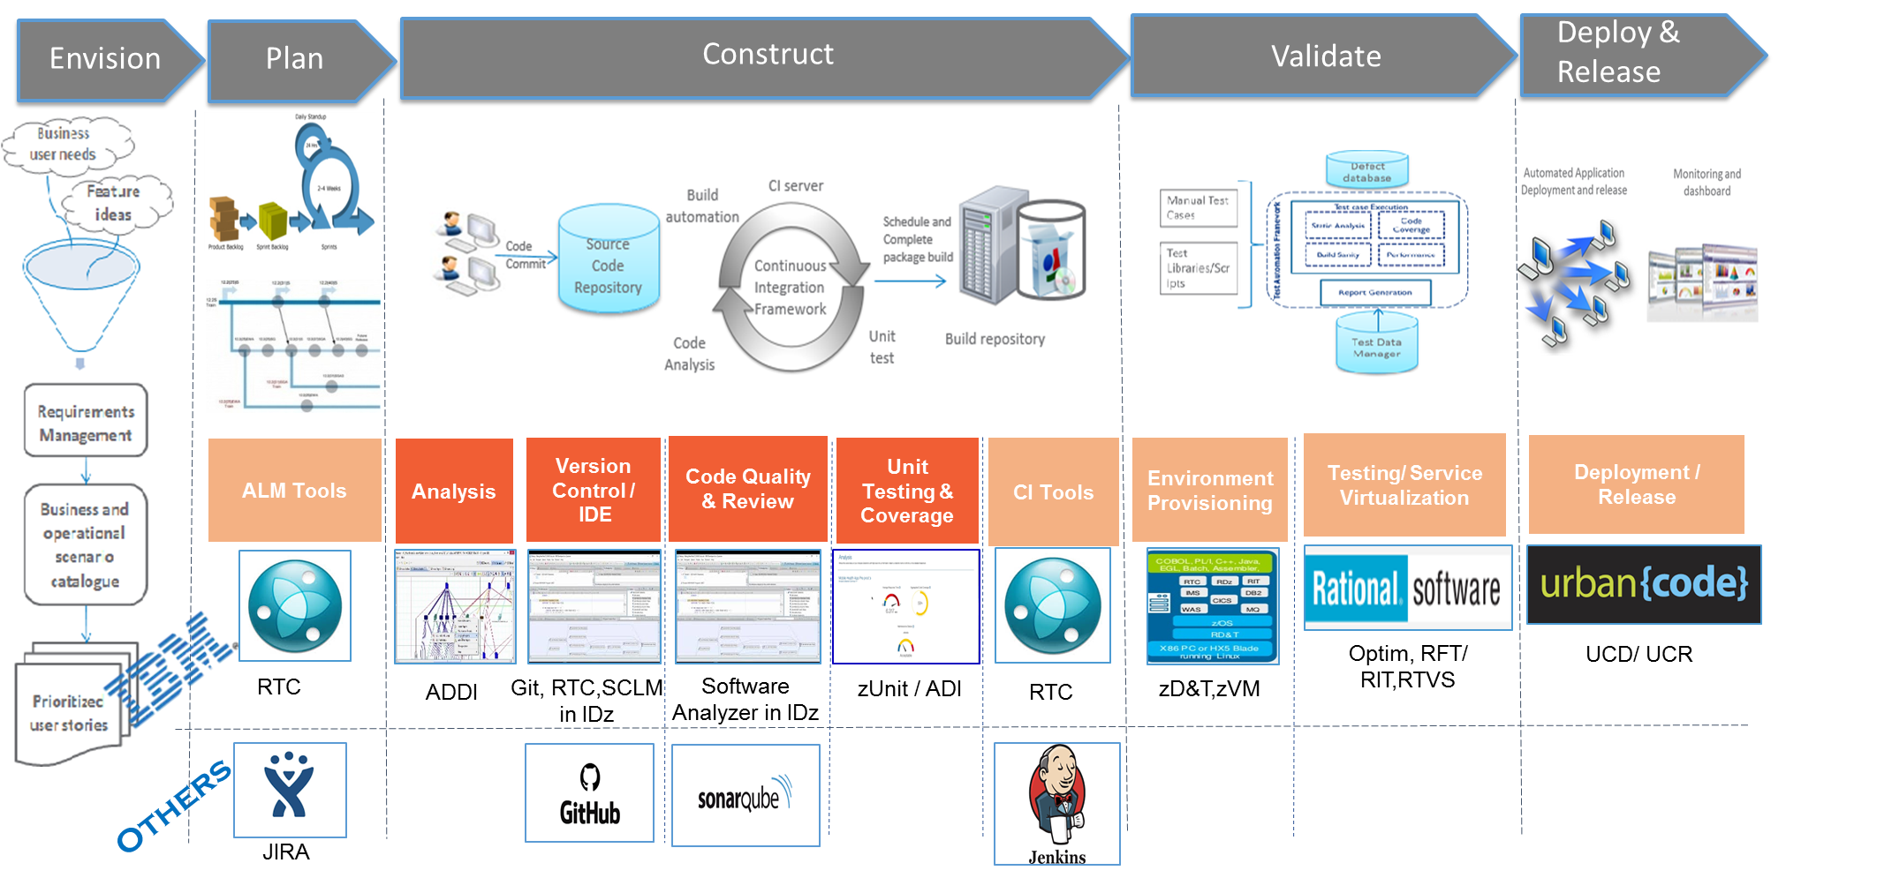
DEMO – 1 : Features of IDz with JIRA, GIT, ADDI Integration

Slide 16
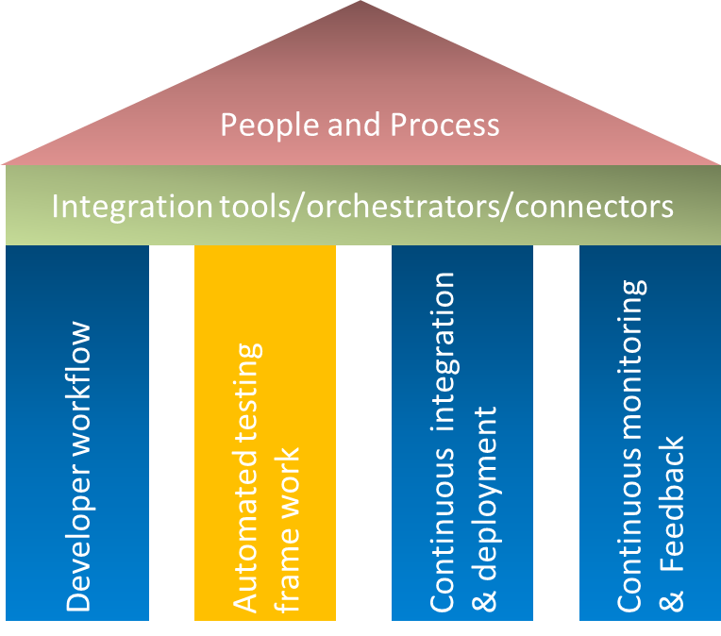


Automated Testing framework
Tester
Trigger the automate work flow
Jenkins
Jira
Continuous Feedback
Continuous Feedback
PoC Scope
Trigger Automated ST/ RT test suite
Code coverage and quality
Automate deploy to ST
Trigger automated ST test suite
Trigger the deploy based on test results
Automate deploy to SIT CIT
1
Automatic
Mainframes Source code
Changeman
Matured
Started
Not Started
XA tester/TFT – code coverage
SonarQube – Code quality check, will be done in PoC
Jenkins - Automatic Trigger ST/SIT Tests, will be done in PoC
RFT – Online Test Automation
UCD – Batch Test Automation
RIT – Service Virtualization for SIT
Optim – TDM Solutions for SIT
zD&T / zVM – Test Environments Provisioning
Jenkins & Jira - Continuous Integration and feedback respectively
Automatic process flow/trigger using Jenkins

Slide 17
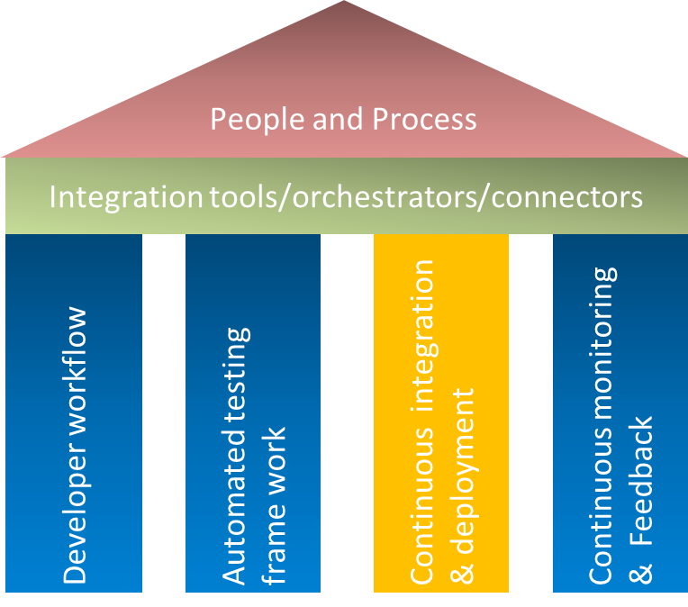

Continuous Integration and Deployment (CI-CD)
Release Manager
PoC Scope
Jenkins
JIRA
Continuous Feedback
Continuous Feedback
Unit Stage
System stage
SIT/CIT
UAT / NFT
PROD
Mainframes Source code
Changeman
Started
Not Started
Automatic Build & Deploy using UCD
Jenkins - Automatic Trigger ST/SIT Tests, will be done in PoC
UCD - Automated code deploy
Jenkins & JIRA – Continuous feedback

Slide 18
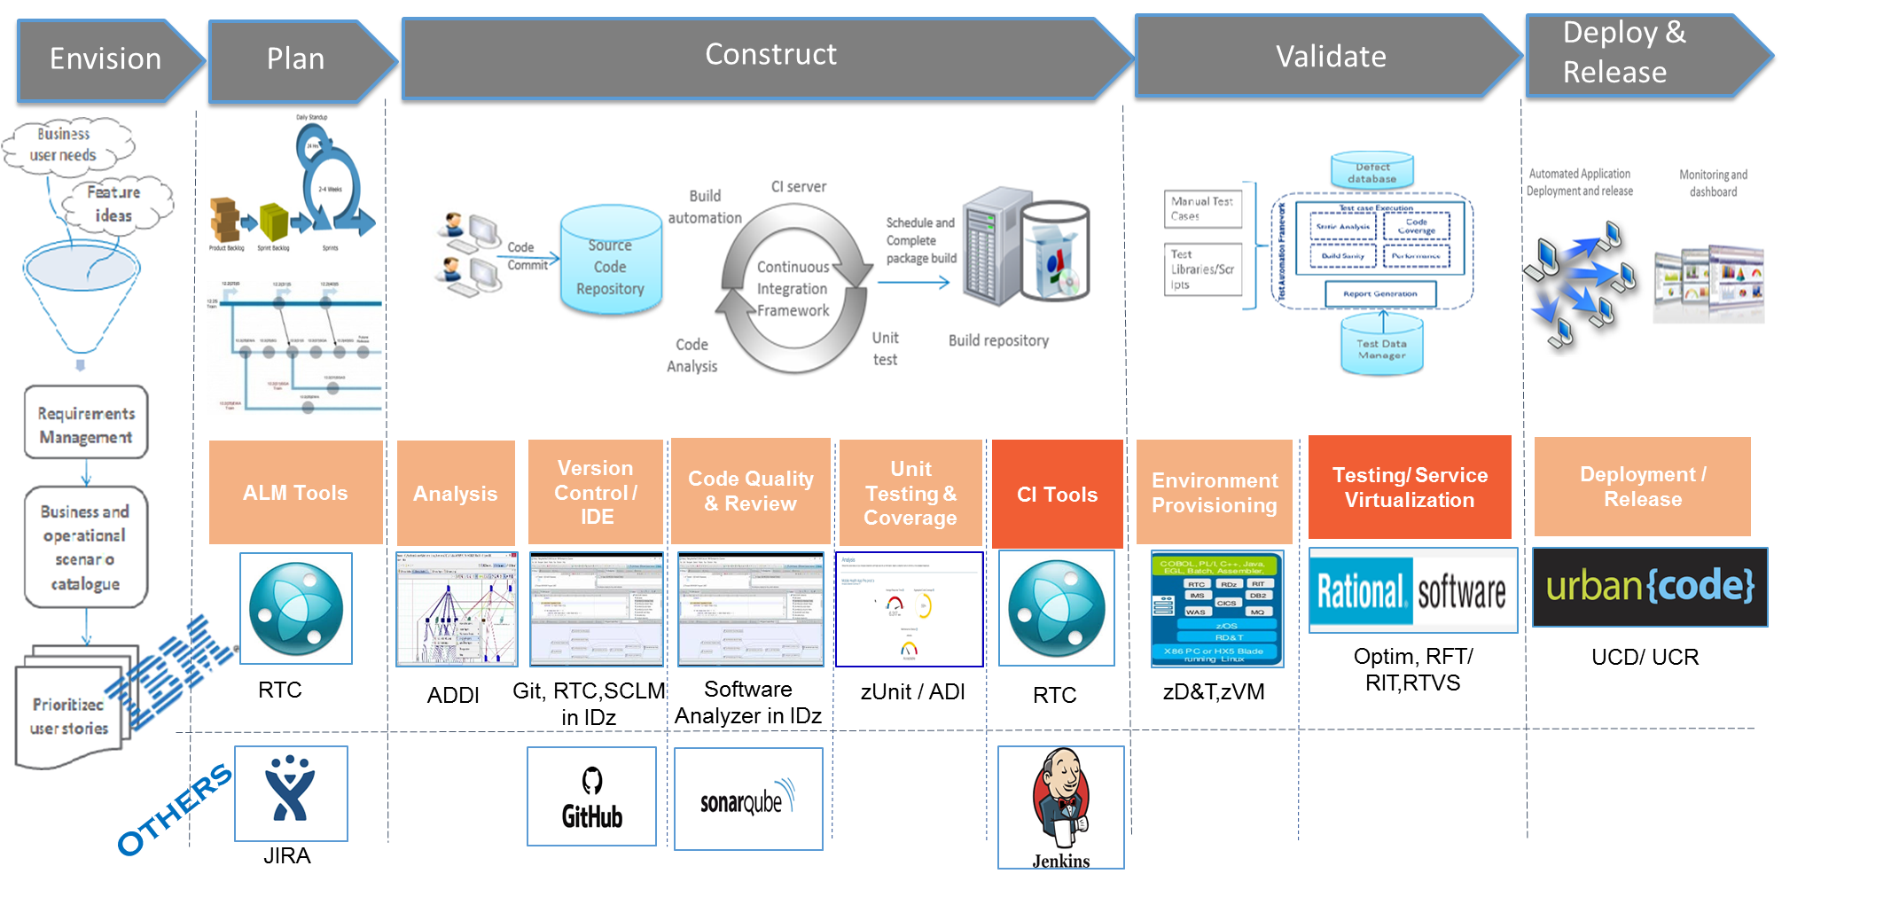
DEMO – 2 : Automated Testing (Continuous Testing)

Slide 19
Next Steps – PoCs under parallel Themes
Process and mindset change
Integration tools/orchestrators/connectors
Developer workflow
Automated testing frame work
Continuous integration & deployment
Continuous monitoring & Feedback
Strategic Solution would be to look at enabling Modern SCMs like Git to allow agile and parallel development
M-SCAN was proposed for a capture of the size of the inventory in Changeman
Immediate
Peer Review
Adoption Strategy
Env Provisioning
Automate End To End Testing
TDM/ SV Solutions
Automate Deployments
Dashboards/ Log analytics
Self Healing scripts

Slide 20
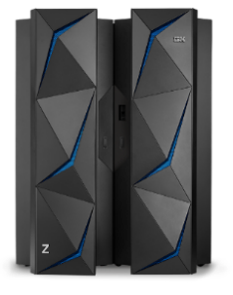

Environment Provisioning Solution Details – From A large European Bank Case Study
Linux on X86 PC
COBOL, PL/I,C++,Java,Batch,Assembler
Virtualized environment for mainframe application development, testing, demo, training
Enables z/OS, middleware and other z/OS software to run on Intel compatible platforms without z hardware
Emulates IBM Z architecture with virtual I/O and devices
Packaged with a toolkit to ease quick and on demand provisioning
Provides flexible environments that can be stood up and discarded on need basis
Provisioning tools have REST APIs for integration with DevOps pipeline
WAS
CICS
RIT
MQ
IDz
RTC
IMS
DB2
UCD
Z software stack
Z architecture simulator
x86 compatible PC running 64 bit Linux
Cloud infrastructure
Environment virtualization scope
Test phase | zD&T applicability
Unit Testing | Yes
System Testing | Yes
Integration Testing | Limited
Performance Testing | No
Pre-prod Testing | No
Development
Unit Test
Component Integration Test
System Test
System Integration Test
User Acceptance Test
Performance Test
20

Slide 21
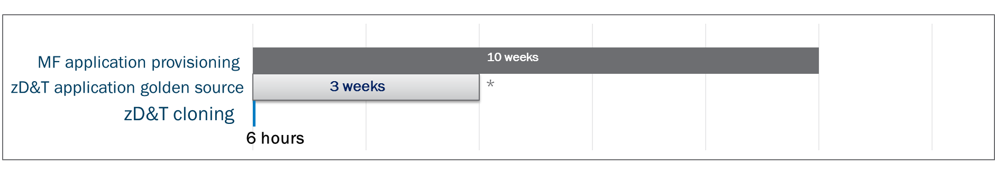
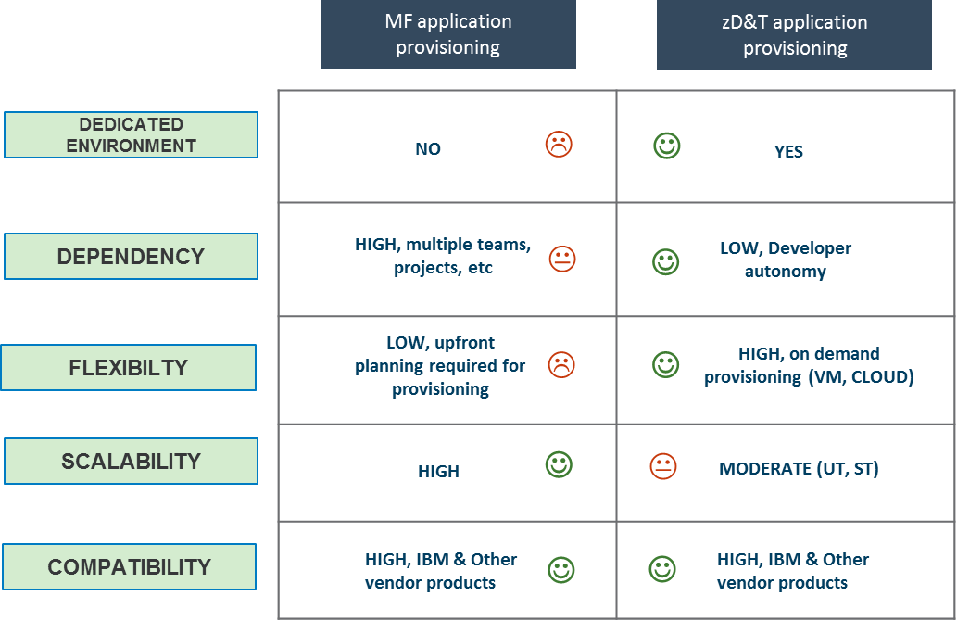
Mainframe virtualization (zD&T) - Outcome
Core application
Application size ~ 1.5 TB
Overall instance size ~ 2 TB
600 DB2 tables
1600 loadlibs, files
53 CICS regions + 2 CICSplex
Solution being rolled out for all of the MF Estate for Lower Environments (UT/ST/CIT)

Slide 22
Automated Environment Provisioning using zD&T using v11 Tools
Key Drivers for Modernization
Target state of zD&T environment provisioning
Perform sanity checks
Deploy the application components
Create new application test environment
Discover the application components
Log onto the web UI of zD&T tools
Linux VM provisioning
Request for new zD&T environment
Select the z/OS conf
Select subsystem configuration
On- premises
Spectrum Scale
Regular
FTP
Server
Developer
OR
zD&T images
OR
zD&T images
Selective application provisioning – 3-4 weeks
ADDI
Provisioning options
From existing IBM Z system
From Application Developers Controlled Distributions (ADCD)
As a clone of an existing zD&T environment
zD&T image cloning
zD&T Tools
Integrate zD&T provisioning with ServiceNow to enable single click environment provisioning
Integrate zD&T with Test Data Management solution
Integrate zD&T with Rational Integration Tester to provide real time stubbing for interfacing components
Cloned zD&T instance#1
zD&T golden image
Cloned zD&T instance#2
…
…..
Cloning from existing zD&T image - < 6 hours

Slide 23
Git for z Systems
Hannah Neumann
Nelson Lopez
IBM DevOps Acceleration Team

Slide 24

Disclaimer
IBM’s statements regarding its plans, directions, and intent are subject to change or withdrawal without notice and at IBM’s sole discretion.
Information regarding potential future products is intended to outline our general product direction and it should not be relied on in making a purchasing decision.
The information mentioned regarding potential future products is not a commitment, promise, or legal obligation to deliver any material, code or functionality. Information about potential future products may not be incorporated into any contract.
The development, release, and timing of any future features or functionality described for our products remains at our sole discretion.
Performance is based on measurements and projections using standard IBM benchmarks in a controlled environment. The actual throughput or performance that any user will experience will vary depending upon many factors, including considerations such as the amount of multiprogramming in the user’s job stream, the I/O configuration, the storage configuration, and the workload processed. Therefore, no assurance can be given that an individual user will achieve results similar to those stated here

Slide 25
What is Git?

Slide 26
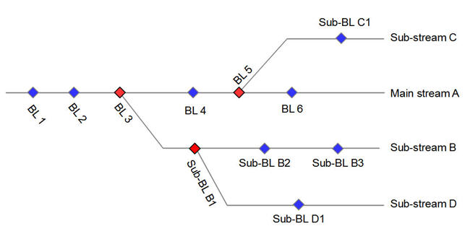
What does SCM stand for ?
Software Configuration Management is the task of tracking and controlling changes in the software
Configuration identification - Identifying configurations, configuration items and baselines.
Configuration control - Implementing a controlled change process.
Configuration auditing.
Source Control Management is a subfield of Configuration Management
Graph structure (line of development, branches).
Atomic operation, version merging, baselines, labels tags

Slide 27
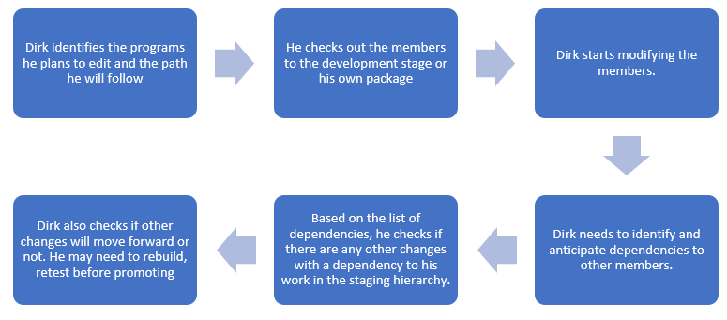
Library Managers
Relies on the concept of concatenation & promotion
Strong connection to execution environment
Limited for parallel development

Slide 28
Full configuration
“A configuration is made up of a given list of files, each of them at a given version. A configuration can have various scopes: for example, an application component, an application, a domain, or more.”
Release 11
Maint.
Release 12
Feature Branch
Feature Branch

Slide 29
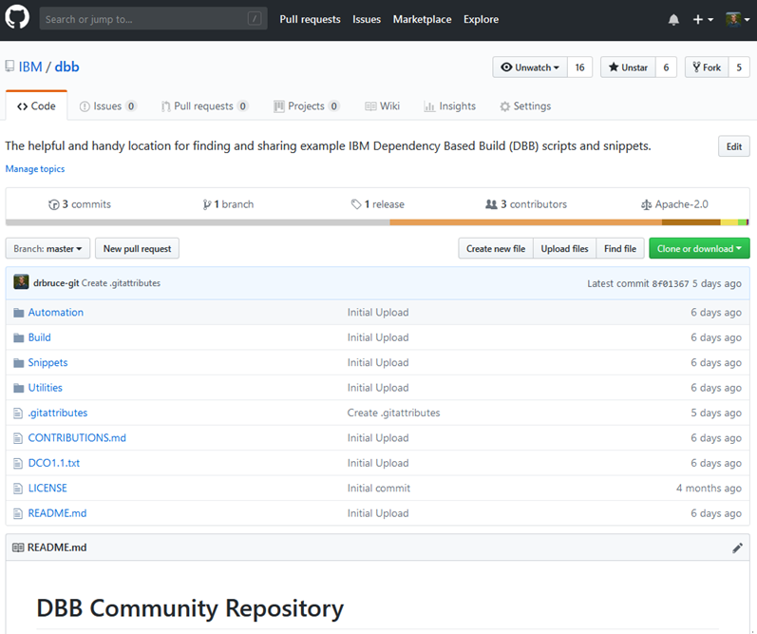
What is Git?
Open Source SCM initially built to manage Linux development
Distributed Source Code Management
Each developer works in their own local Git repository on their machine.
In most large companies today, there is a centralized instance of Git that is considered the server
Uses a commit ID instead of a version
SHA-1 hash based on the code, what came before it, who made the commit, when they made it, and other metadata
Used with other open source tools such as Jenkins, Ant, Maven, Gradle for Continuous Integration / Continuous Delivery pipeline
Strengths
Simple, cheap and easy to deploy
Pervasive in Open Source development where there is no effective competition
GitHub, GitLab, and BitBucket are common Git based web hosted repositories.

Slide 30
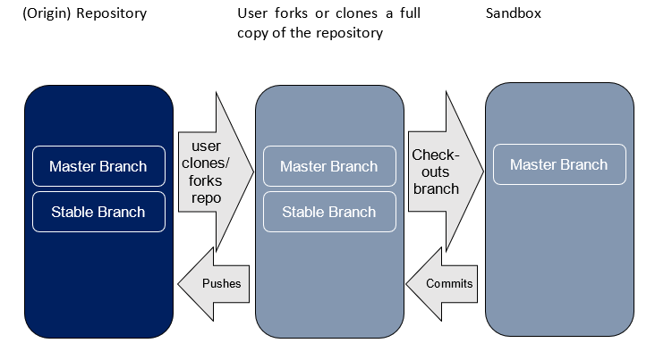
Git in a nutshell

Slide 31
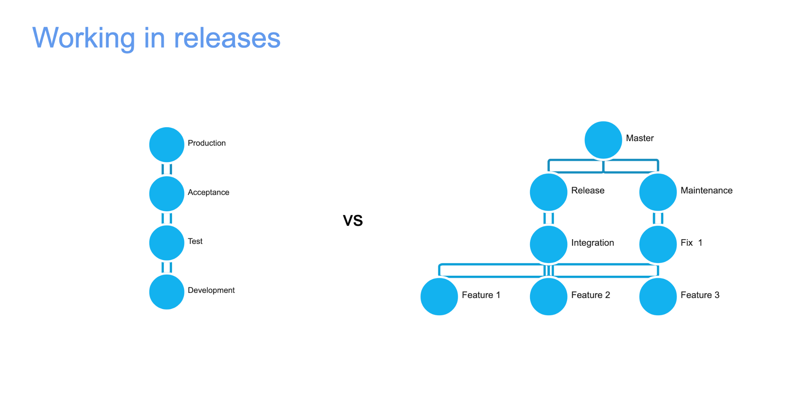

Slide 32
Using Git with IBM Dependency Based Build (DBB)

Slide 33
IBM Dependency Based Build (DBB) – Key Features
DBB is a tool that provides an Intelligent build environment for mainframe applications stored in Git.
It can support your overall CI/CD solution as well as support individual developer builds within IDzEE.
It uses a multi-language source code scanner to find dependencies for Assembler, C/C++, COBOL, and PL/I source files to automate your build process (compile & link edit).
It provides a Java API Tool Kit and a WebApp and Database to build and manage your application’s dependency metadata and build results.
You use the Groovy scripting language to automate impact analysis and drive your build process – “no JCL required”.
Use the same scripts for your continuous integration (CI) pipeline and your developer’s daily “user build” cycle with ZOD or IDzEE.
Sample Scripts are provided to get you started

Slide 34

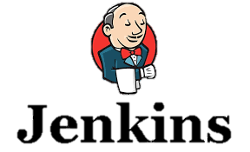


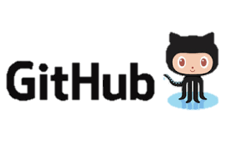
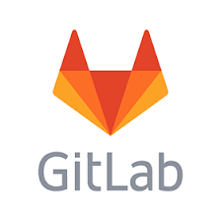




DBB Architecture Overview - CI workflow
DBB, includes a free port of Rocket Software’s Git and Apache’s Groovy runtime for z/OS. It can be configured with any DevOps orchestrator like Jenkins and any Git Host service like Git Hub.
DBB WebApp
- Dependency Metadata
- Build Results History
Start Pipeline
Status, logs and links to reports
Git Server
DBB Toolkit
Groovy Build scripts
CLONE to USS
Agent
USS
MVS
API’s
Main Repository
PDS
Scan, impact analysis, copy to PDS, compile, link-edit & report.
Compile &
link
Run Groovy build script

Slide 35
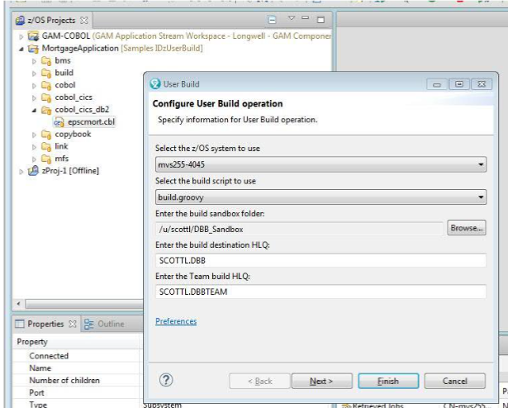
DBB and IDz – User Build
DBB can be used within IDz’s “User Build” feature
Provides all the benefits of a dependency based build
No JCL knowledge needed
Does not rely on Rocket Git or Jenkins

Slide 36


DBB Impact Build Scenarios
Here are 2 scenarios to explain how DBB works when a change is made to a sample application of, lets say, 3 programs and 3 copybooks.
If we change CYP-2, DBB will return a build-list of “PGMS A,B,C“ for the build.
If we change PGM-B, DBB will return “PGMS B & C” for a build.
Sample application and related dependencies in a Repo
DBB Result - Build List
PGM-A
CPY-1
CPY-1
CPY-2
Scenarios
PGM-B
PGM-A
CPY-3
CPY-2
Change CPY-2
PGM-C
PGM-B
CPY-3
PGM-B
CPY-2
PGM-C
Change PGM-B
Static Link
PGM-C
CPY-3

Slide 37
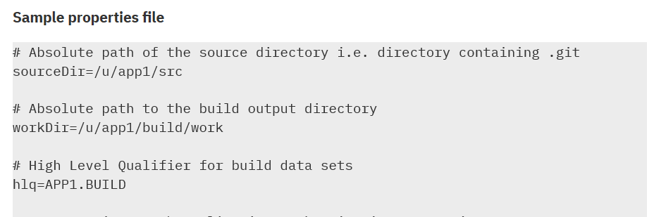
DDB – A Sample Groovy Compile Script
import com.ibm.dbb.build.*
println("Copying source from zFS to PDS . . .")
def copy = new CopyToPDS().file(new File(“$sourceDir/helloworld.cbl"))
.dataset("USR1.BUILD.COBOL").member("HELLO")
copy.execute()
println("Compiling . . .")
def compile = new MVSExec().pgm("IGYCRCTL").parm("LIB")
compile.dd(new DDStatement().name("SYSIN").dsn(“$hlq.BUILD.COBOL(HELLO)")
.options("shr"))
… other dd’s
compile.copy(new CopyToHFS().ddName("SYSPRINT")
.file(new File(“$workDir/build.log")))
def rc = compile.execute() if (rc > 4) …
Blue text are example DBB APIs, orange are properties

Slide 38
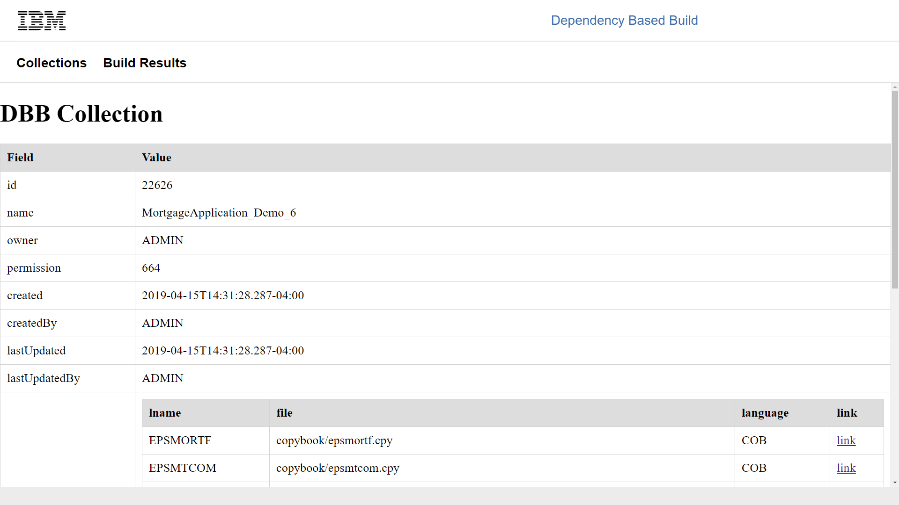
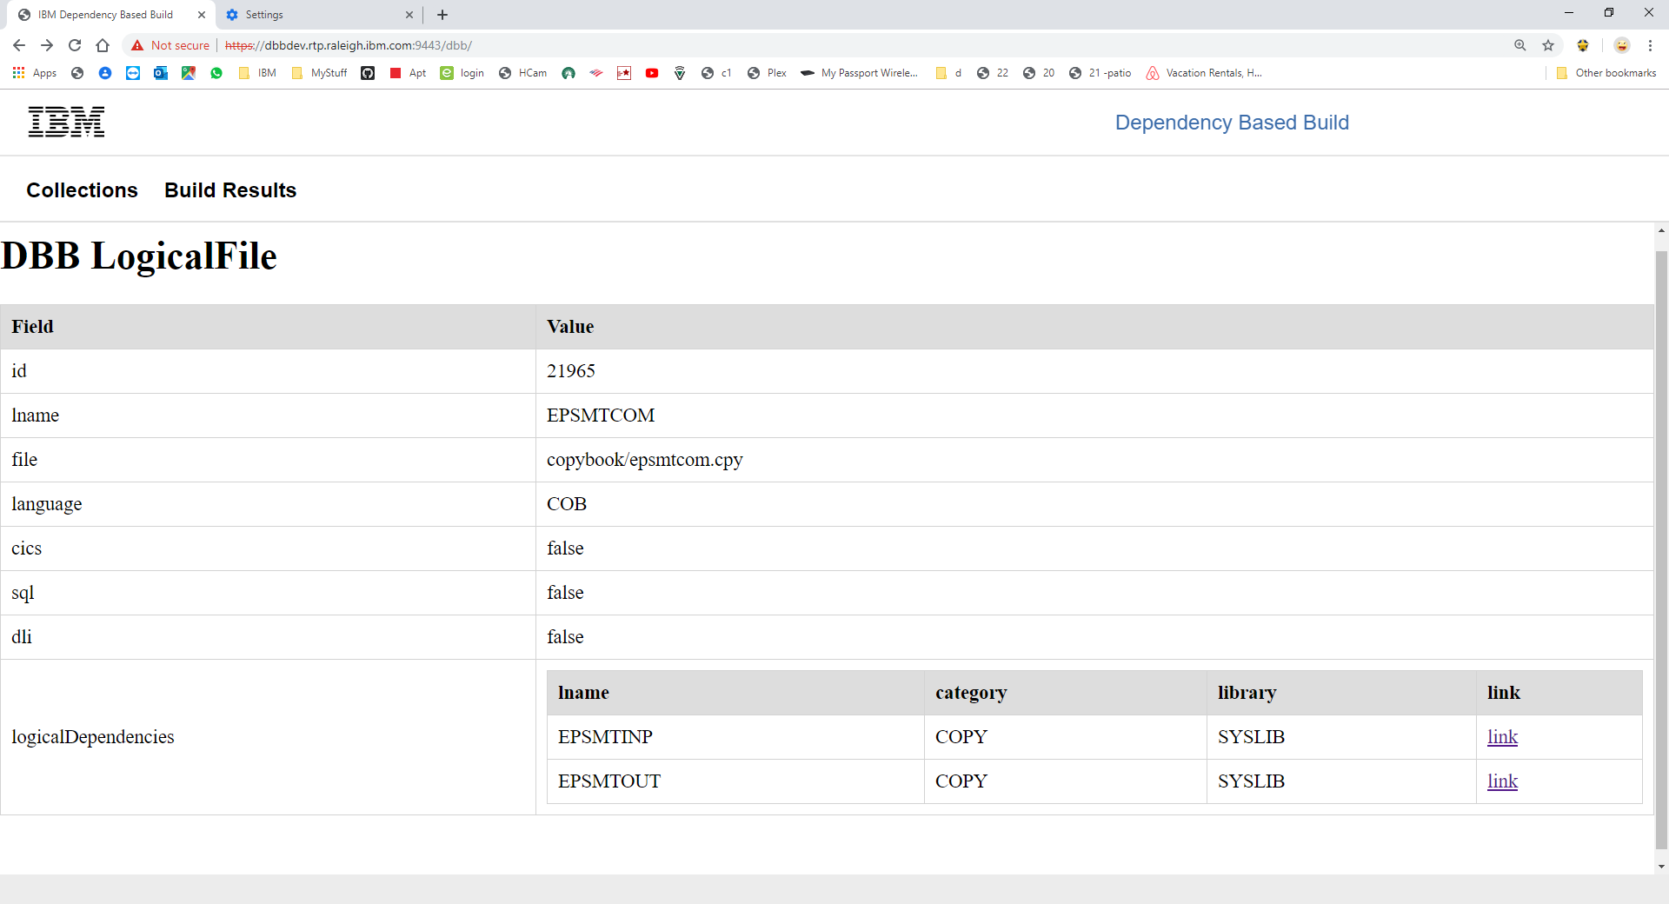
DBB’s WebApp - Application Metadata
DBB stores, maintains and queries your application’s program dependencies to other programs and source files like copybooks and BMS maps during a build.
Drill down for details

Slide 39
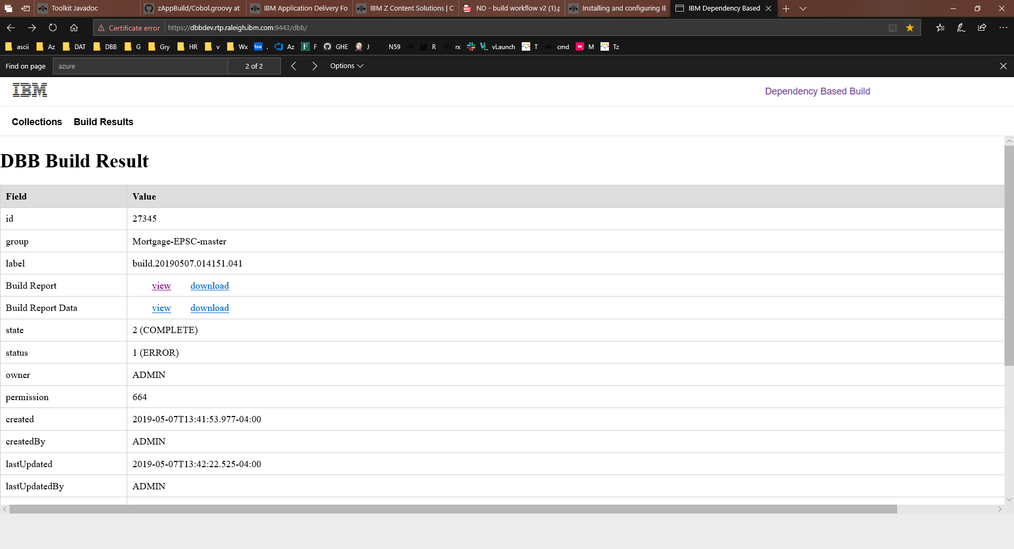
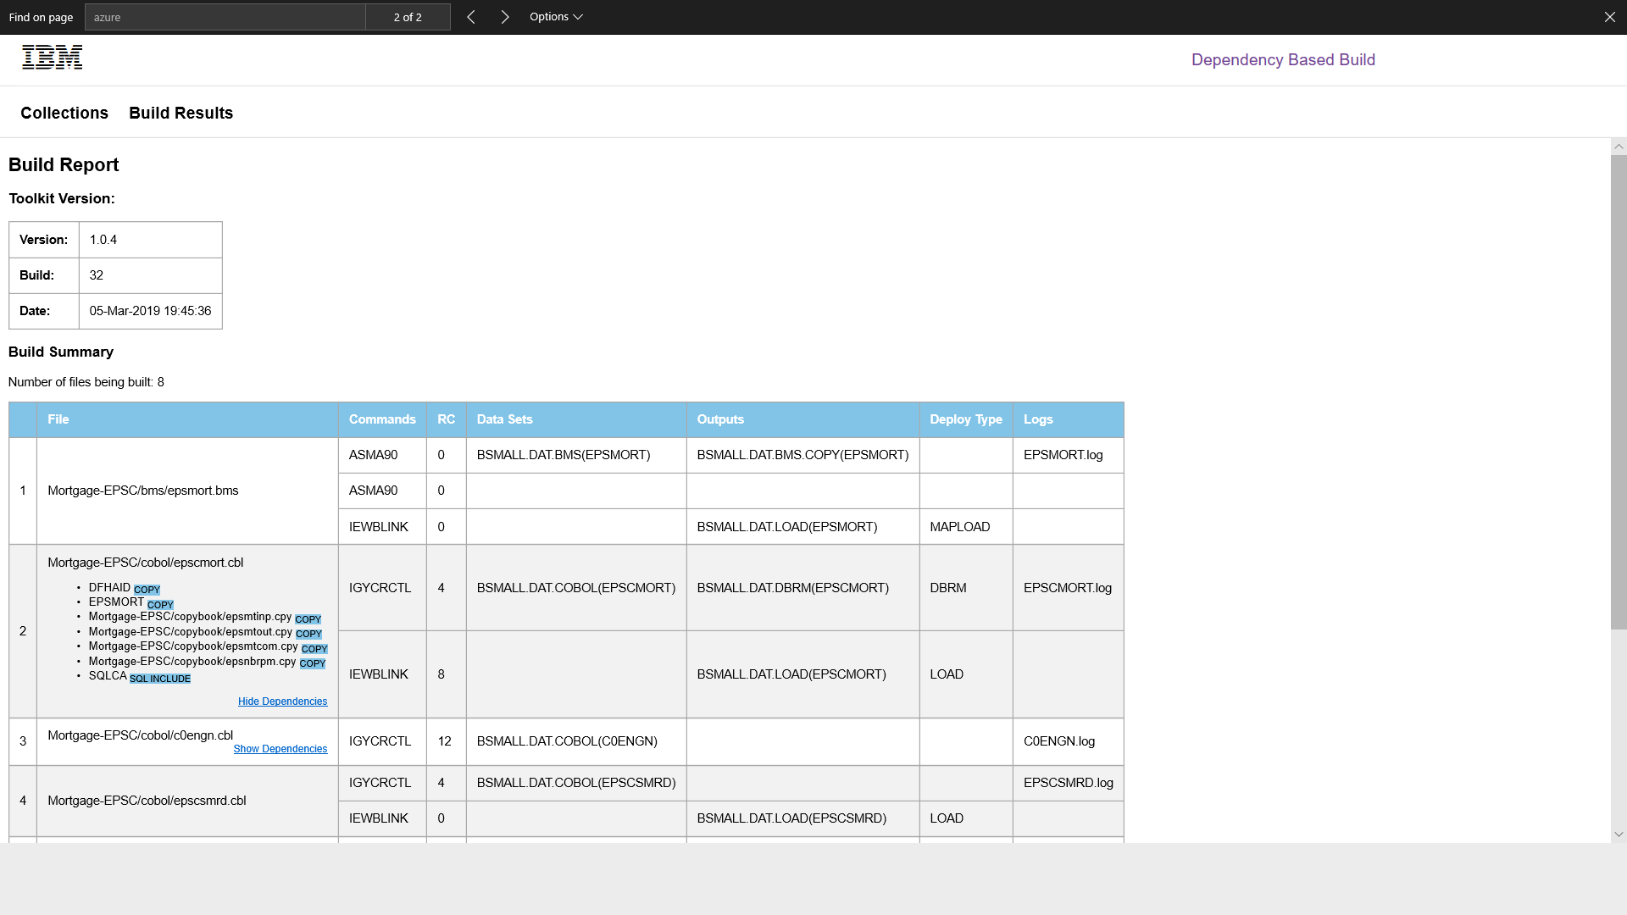
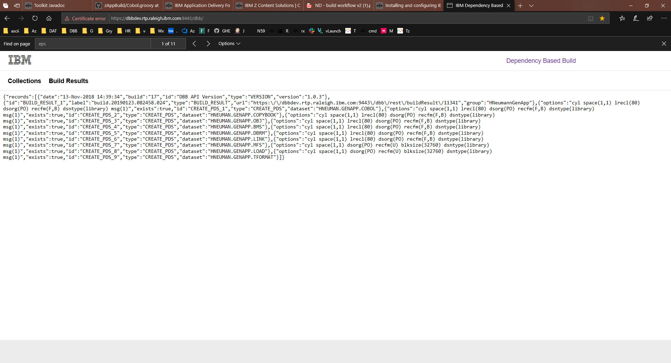
DBB’s WebApp – The Build Report
DBB generates build reports viewable from a browser. It also creates a machine-readable JSON file to drive your automated Continuous Deployment (CD) process.

Slide 40
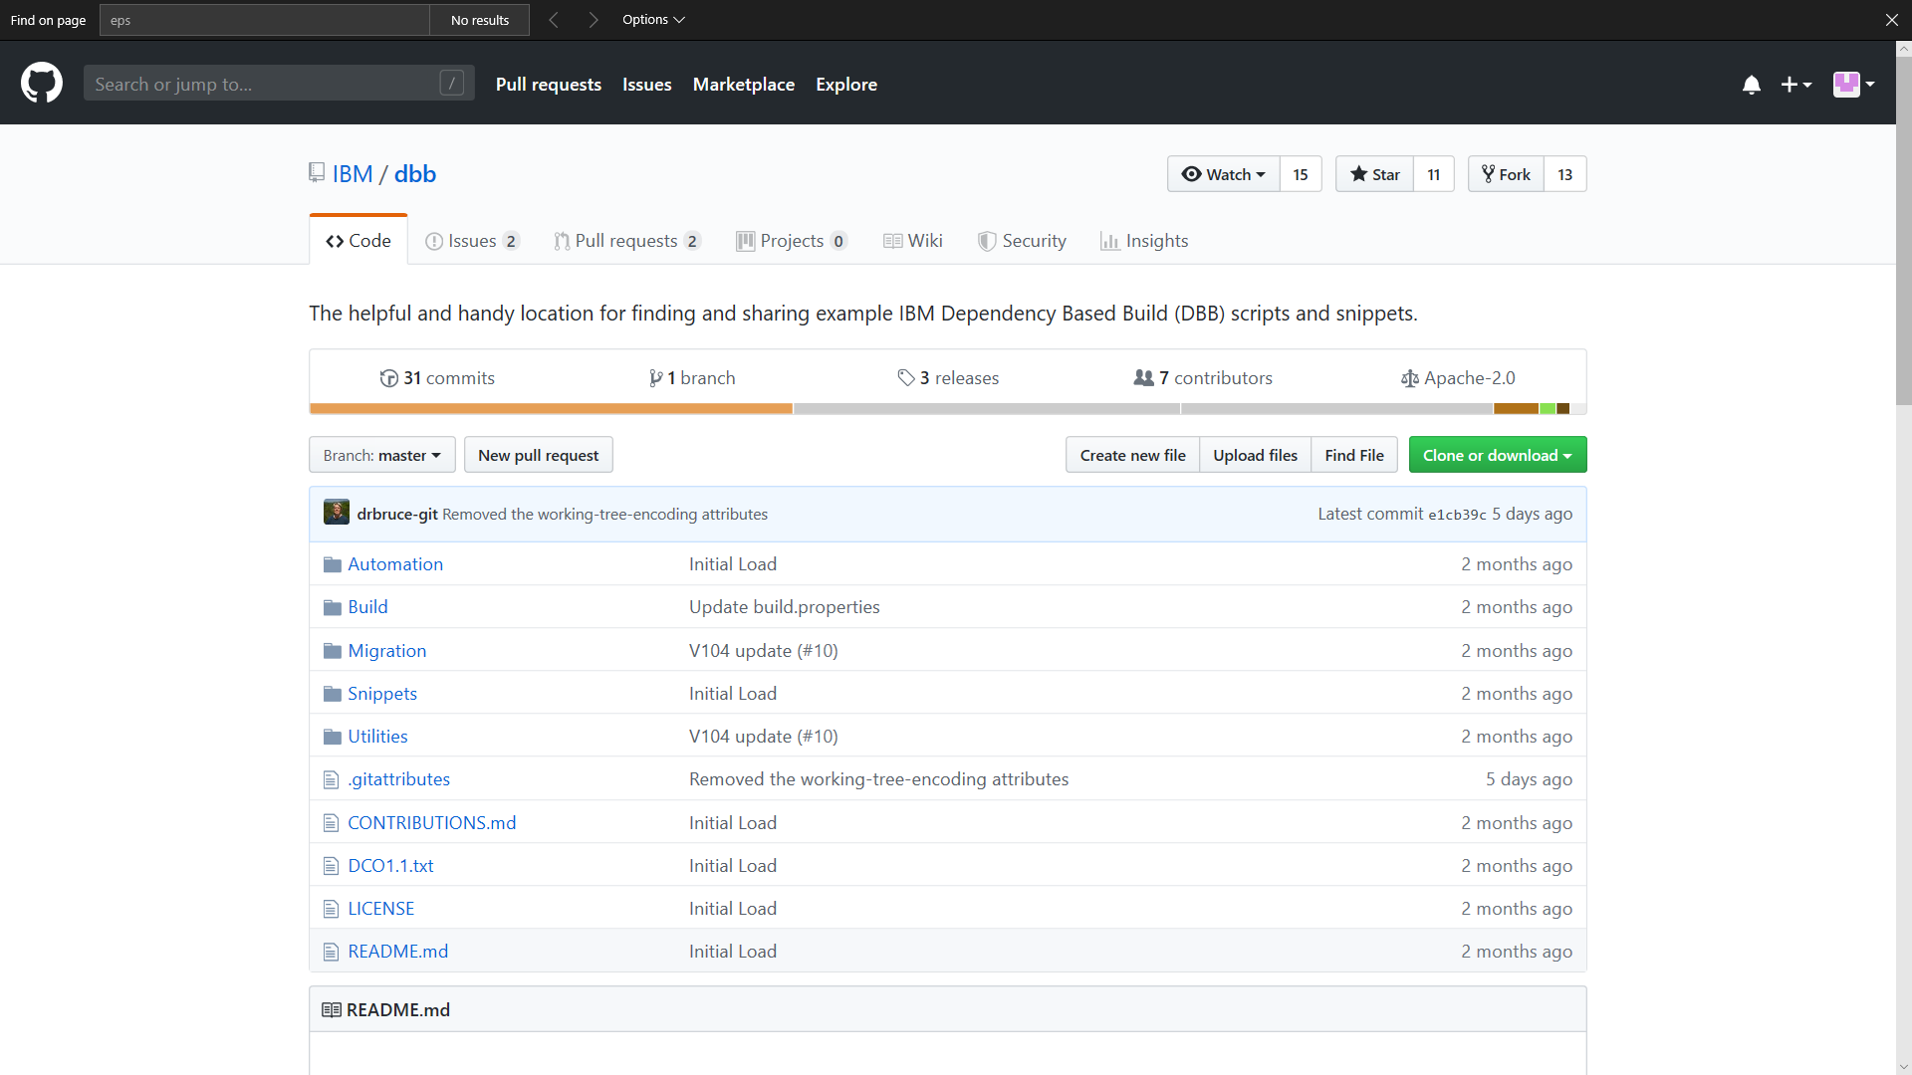
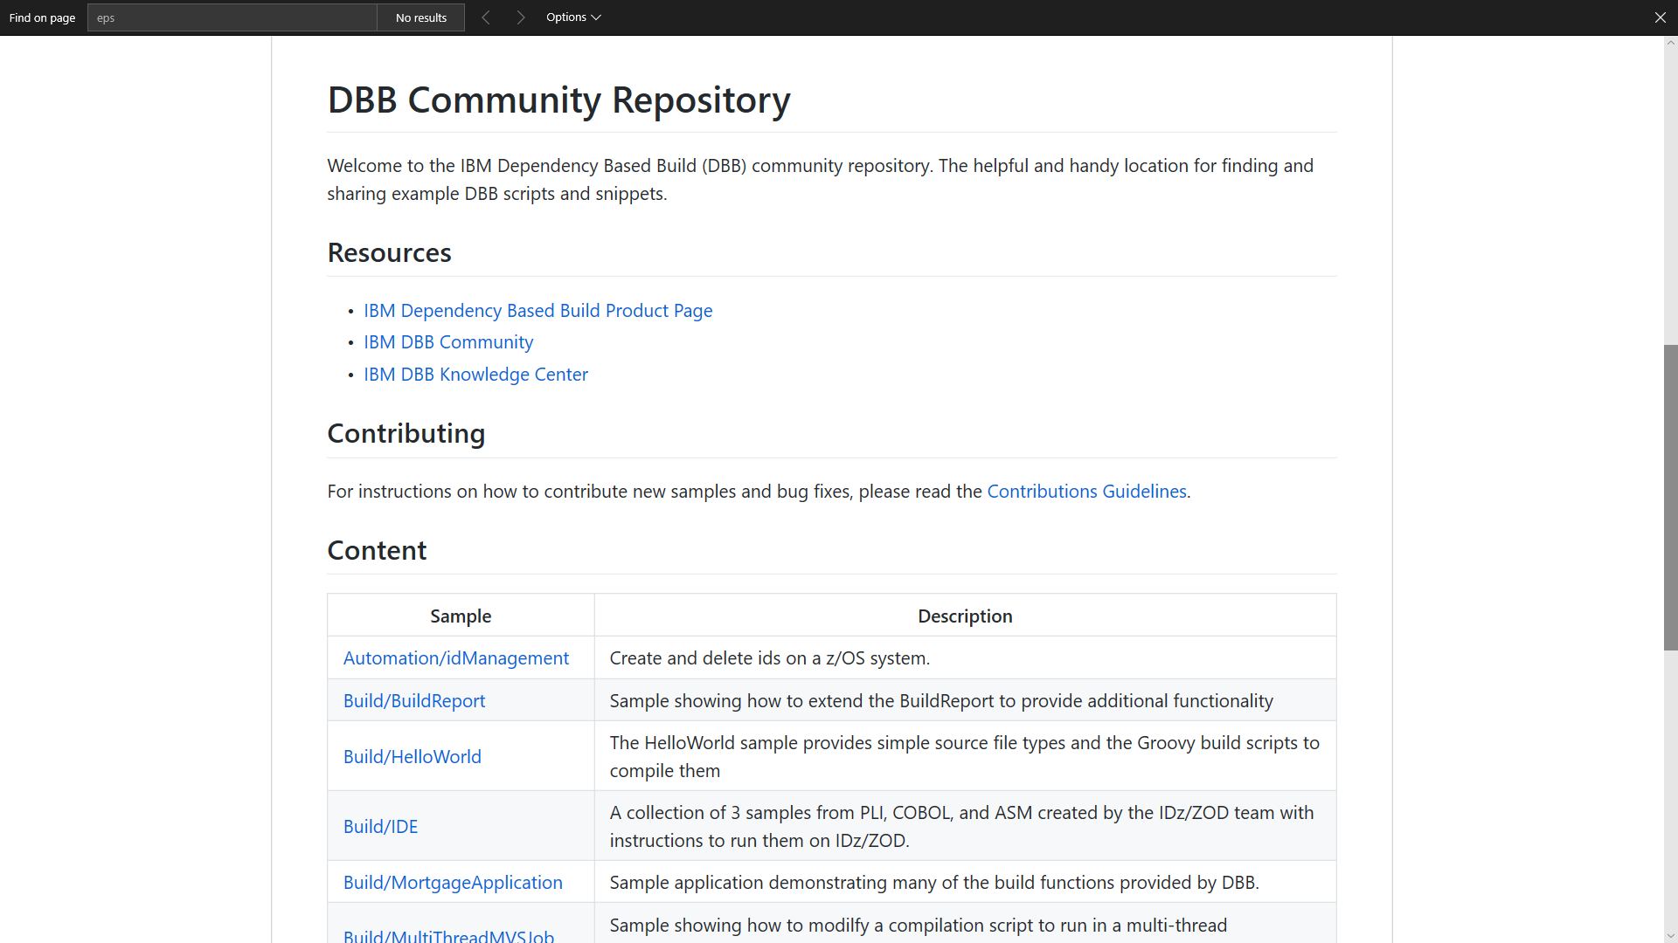
Find us on Git Hub - https://github.com/IBM/dbb
Samples, documentation and other resources
Case Study: https://developer.ibm.com/mainframe/2019/03/25/devops-transformation-on-ibm-z-with-git-and-ibm-dependency-based-build-a-case-study/

Slide 41
Migration Path from Current State to Git-DBB Solution

Slide 42





Migration process and tools
Analysis Tools
Questionnaire
Extraction Tools
BP/Client Tools
Scanner Tools
Application discovery (ADDI)
Migration Tools
SCLM Mig Toolkit
Import Tool
JCL Mig Tool
CI/CD
CI/CD Pipeline
Analyse
Extract
Componentize
CI/CD
Migrate
Analysis
Analyse the development process, Infrastructure and document the current state
Extract Metadata, Source Libraries, Compile Procedures and options, Languages, File types from Host SCM
Identify Interfaces and dependencies between applications and componentize
Derive future state architecture
Establish CI/CD workflow
Product deployment
Setup repos and Import
Setup the scripts and establish the pipeline

Slide 43
Breaking down the monolith - Interactions of applications
Application 1
Application 1 separates into public interfaces and its implementation
Application 2 follows the same mimic, but also uses services from App1 and App3. Therefore the configuration requires at least the interface description to be buildable
Public Interface of Application 1
Private Implementation of Application 1
Application 2
Application 3
Public Interface of Application 2
Public Interface of Application 3
Private Implementation of Application 2
Private Implementation of Application 3
Interface of Application 1
Interface of Application 3
Interface of Application 1

Slide 44
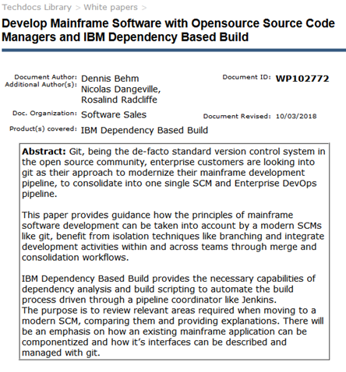
Git Migration White Paper
http://www-03.ibm.com/support/techdocs/atsmastr.nsf/WebIndex/WP102772
Moving from a legacy z/OS Library Manager to Git is not just about tools.
There are some key differences between traditional and modern SCM approaches.
This whitepaper is a synthesis of expert guidance learned in collaboration with mainframe development organizations.
Explains how to adopt and manage the transition at a process level.
Hash a special focus on how an existing mainframe application can be componentized and how the application interfaces can be described and managed, as well as built.

Slide 45
Simplify your Journey towards DevOps transformation through DevOps Acceleration Program(DAP)
DAP provides with expert advise on the best transformation approach for your enterprise, from any model to DevOps.
It includes how-to guides on culture, best practices, tools, training, and even sample code and architectures
Product Deployment
Deployment preparation
Rollout planning – Workflow and Use Case analysis
Assistance on Installation, Configuration, Optimization
Best Practices – in the areas of production Adoption
SCM Migration
Assessment of current state client setup
Transformation/Product workshop and Future state High level architecture
Representative Migration
Migration approach for future implementation
Knowledge transfer
For further details about the program, please contact
mfdevopsaccelerator@ibm.com , jayakarm@ibm.com

Slide 46


Proposed vision for CI/CD @Ameriprise
Continuous Feedback
Automated process using Jenkins
Work items planning, CI/CD Dashboarding:
JIRA
Developer workstation - RDZ
ADDI – Analysis and Impact report.
Code check- out.
Coding + Sonar Lint
Unit testing + Code Coverage (XA Tester).
Peer review (SmartBear)
Code check-in
Developer
Trigger Jenkins
Mainframes Source code
Jenkins agent
Git /DBB
UCD agent
Continuous Integration and Orchestration layer: Jenkins
Automated Pipeline
Get JIRA completed Stories/ Changeman Elements
Code quality review
Regression testing
Promote to ST
Deploy to System integration testing
System integration testing.
Deploy to User Acceptance testing
SonarQube
UCD
SonarQube + XA Tester
Automated FT
Automated SIT
UCD
Git repository of test cases

Slide 47
Q&A
THANK YOU

Slide 48



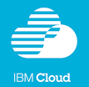




Continuous Testing Solutions
Development
SCM
Build
Artifact
Repository
Test
Environments
Prod
Environment
Automate Regression Test Packs – Run regression tests after deployment to each environment
Automate Functional Testing and virtualize interfaces that are not available
IBM Rational Test Workbench
Enable performance, integration and functional testing, including terminal based, throughout your project lifecycle
With a scriptless, wizard-driven test authoring environment and support for more than 70 technologies and protocols
IBM Rational Performance Test Server
Save time and effort by reusing your functional integration tests for performance testing
Combine your tests to model real-world scenarios and assess the impact of load on your integrated infrastructure.
IBM Rational Test Virtualization Server
Model real system behavior to eliminate test dependencies and simulate production,
Accelerate testing and reduce the setup and infrastructure costs of traditional testing environments.
QA
DEV
Test Workbench
Functional Testing Integration Testing Performance Testing Regression Testing
Test Servers
Load Agents Virtualization Agents
Test Lab Infrastructure

Slide 49
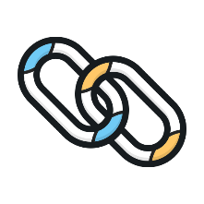

DevOps “People” – Solution to Developmental Challenges
CHALLENGES
SOLUTION
Re-skilling, Up-skilling through Boot camps
and inductions for Agile and DevOps
Regular training sessions to showcase the
benefits of the model
Encouraging Product Mindset
All members of the team should have the
visibility of the business value of the project
Usage of automation wherever possible to
mitigate dependency on ‘champions’
Culture Paradigm Shift for the Ageing Workforce
Inertia to Re-Skill
Low motivation for Legacy
Systems
Notes:
Infosys ETA and Lex

Slide 50
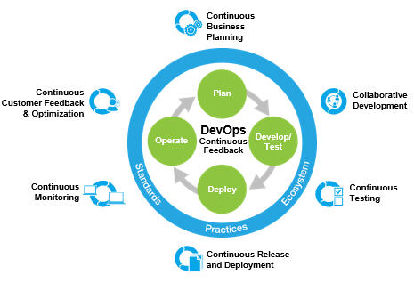
DevOps “Process” – Solution to Developmental Challenges
SOLUTION
CHALLENGES
Agile Adoption on a wider scale. Recommend
Agile Pod structure
Lean Thinking, introducing practices like
Value Stream Mapping, gamification
Eliminate Waste – Automate everywhere
Continuous Integration and Delivery to
assure faster time to market
Continuous monitoring and feedback to reduce response time
Break Silos/ Collaborative
Traditional Cumbersome
and Manual Processes
Lack of Agility
High response time to Business Changes
Lack of Collaboration
Notes:
Infosys Enterprise Quality team
Value stream mapping
Lean Processes
Eliminate Risk

Slide 51
Challenges Faced
Encountered unknowns in various stages of tool procurement and installation. High Installation cost by IBM being one of them.
Slow turn around time at multiple steps of PoCs in various process streams, including IBM for installation SOW.
There have been multiple instances of software compatibility issues. The procured software were not backward compatible causing the vendors to make fixes.
High Software Costs have been a deterrent in pursuing some initiatives.

Slide 52
A DevOps on MF Case Studies

Slide 53
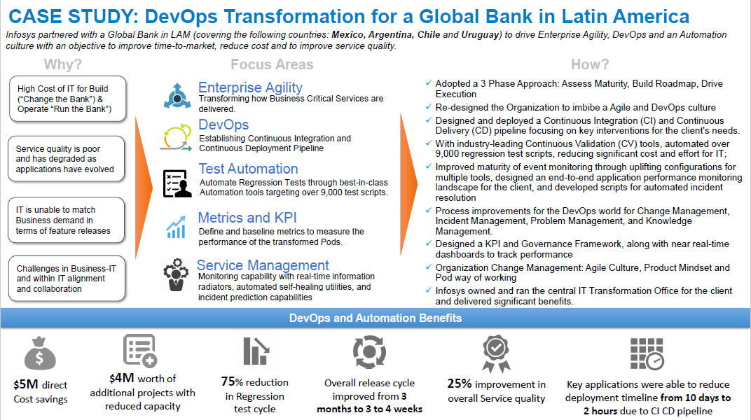
Notes:
230+ Applications, around 100+ Mainframe Applications

Slide 54
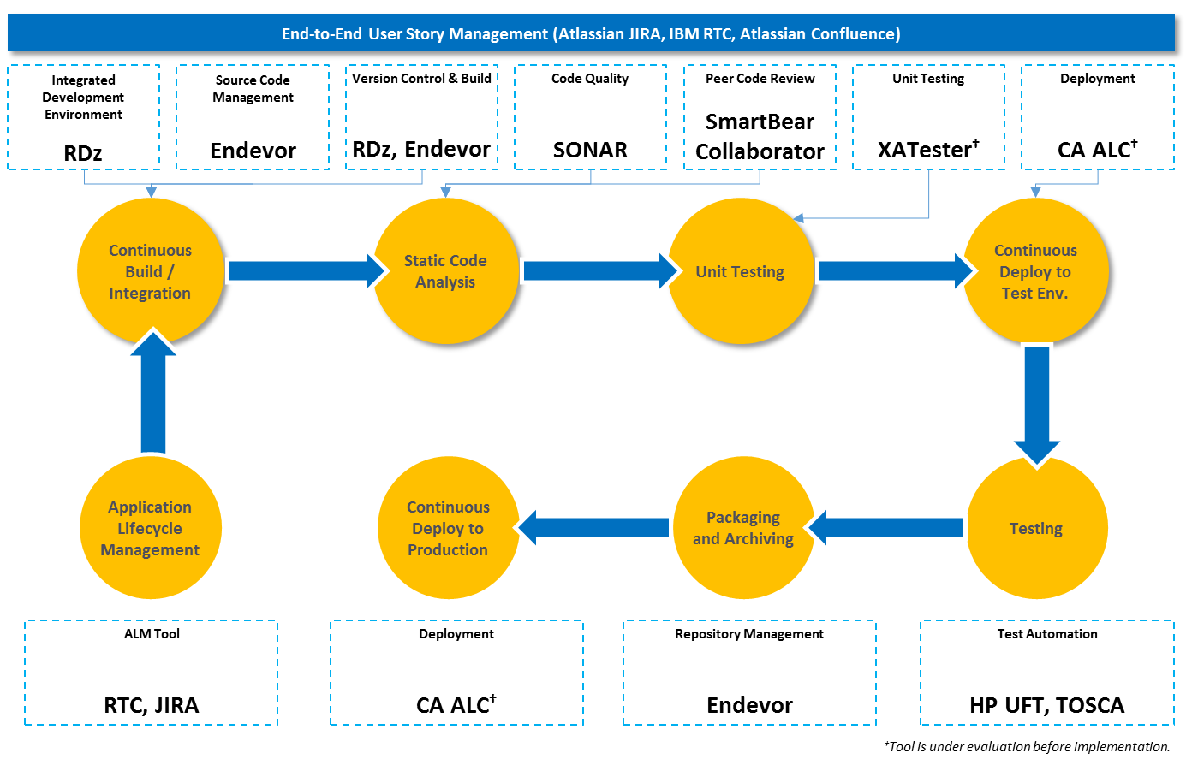
DevOps Implementation in Mainframe Portfolio for a BFSI MNC

Slide 55
Case Study – DevOps on Mainframes for one of largest banks in Europe
Client Overview
Business/Technical Drivers and Pain points
One of the largest UK based multi-national financial services corporation
Bank targets to go agile on release cycles and prepare a roadmap to implement DevOps to deliver values faster to customer and reduce time to market
On analyzing the Development lifecycle, it was found that around 40-50% of the project duration was spent in testing, which was mainly due to delays in test environment provisioning
Developer/Testing productivity – Manual process and over heads.
No dedicated lower environment for System integration and Unit testing.
Infrastructure Team dependency and rigid controls causing delays
Shift left by testing the code earlier and faster and there by reduce the time to market
Free up mainframe development and test MIPS for production capacity
Technical accomplishments
Challenges Faced
Rolled out zD&T environments for 25+ applications are created
Roll out of zVMs to be used for higher environments provisioning
Automated most of the manual processes in Environment provisioning
CI/CD Tools like ADDI, IDz, Topaz Workbench, Topaz for Total Test, CA-Automic and XATester were tried out successfully on zD&T
Test Automation, Deploy automation, Developer workflow completed using Topaz Workbench packaged with JIRA, Endevor, Git, SonarLint
CICD Pipeline PoC Completed with tools – JIRA, CA Endevor, SonarQube, Topaz Total Test, UCD, Silk Central integrated via Jenkins
Enhancements and Pilot of the CI-CD Pipeline in Progress
Application scoping, Missing Components, Middleware identification
Access, Privileges , FTP restrictions, Storage Constraints
Post-provisioning customization
Lack of Automation
System programming Skillset
Rigid Governance & Controls for PoCs also
Dependencies on interfacing applications
Silos between Dev, QA and Operations
Tools with required versions not available
Open Source tools need ETF / IT Security approval

Slide 56
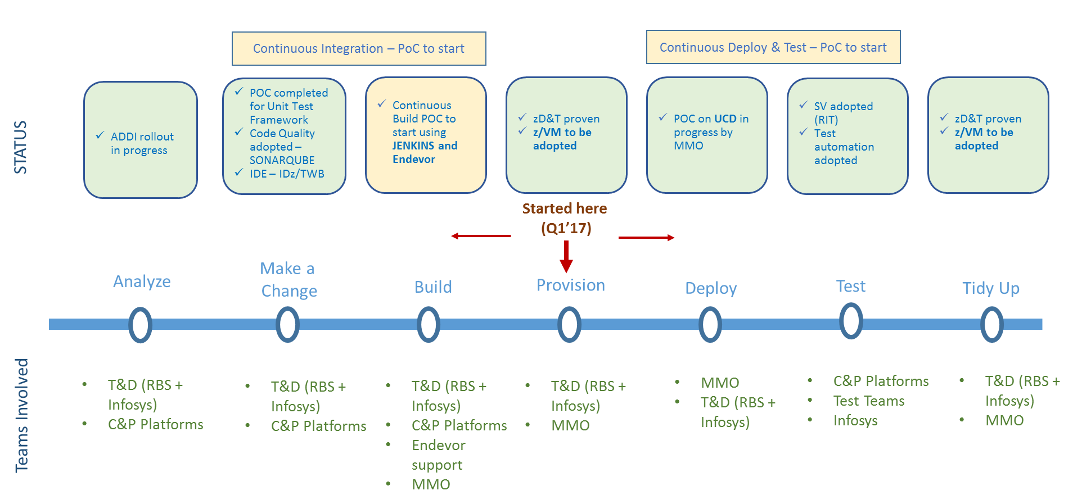
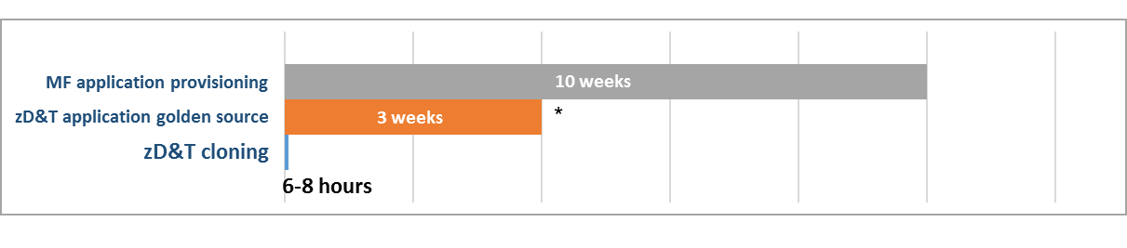
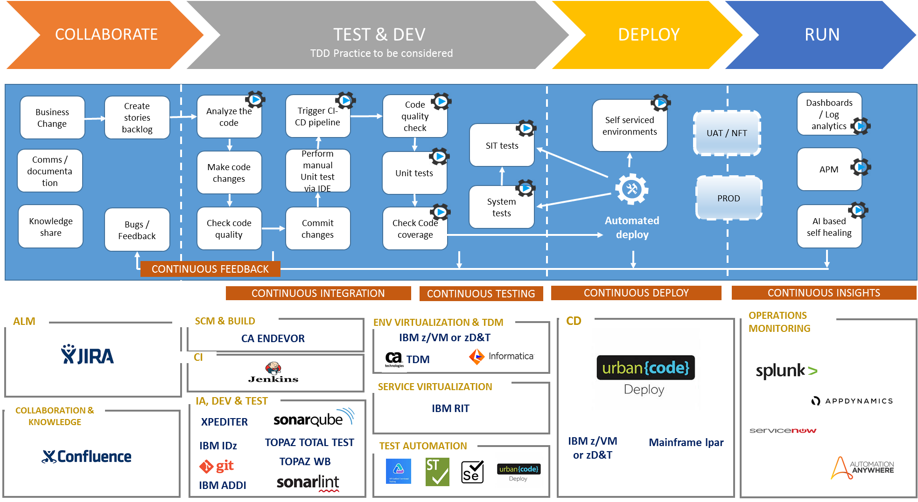
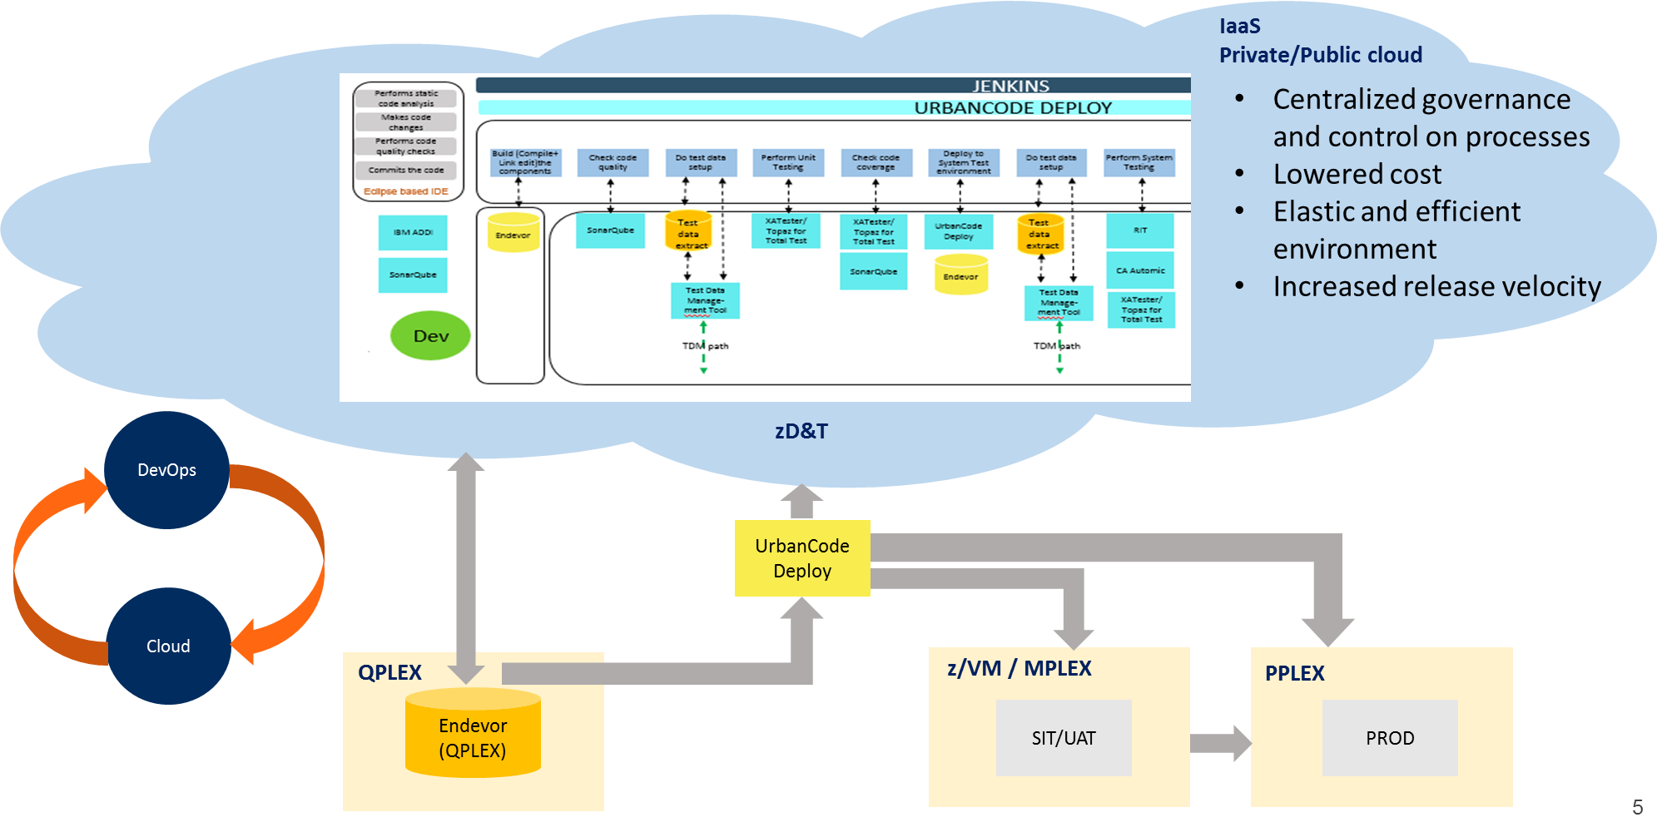
The Journey …
Mainframe Containerized
Our Approach
A mainframe environment clone could be spun up in ~6-8 hrs as opposed to ~2 months on native mainframe
Resulted in overall reduction of ~30-50% of System testing time
Pioneered MF CI-CD Blueprint
Future Cloud strategy recommended
We are here

Slide 57
The Vision…
Improvement in
Code Quality (~10%)
Dev. Productivity(15-20%)
Automated Env Provisioning – Dev places a Serv. Now Request and env with application and Data available in 8 hours
Automate the Automation –
Use AI to identify automation critical paths
Model Based test case generation
3. Leverage zVM, zOS/PT and zOS MF to extend the environment provisioning acceleration for SIT and UAT environments
Developer Workflow + CI
Cycle Time Reduction (~30%)
Developer Empowerment
On Demand Release Regime
Environment Provisioning
CD +
One Click Deploy
Cycle time reduction (~20%)
Test Automation + SV + TDM

Slide 58


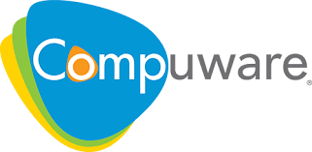




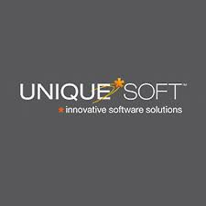

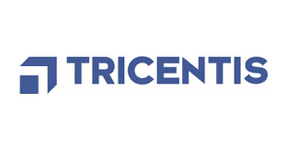

Our Differentiators
Key Drivers for Modernization
Infosys legacy modernization practice has a strong focus on “DevOps for Mainframes” under the “Renew” Solutions of the ART (Accelerate-Renew-Transform) framework
Infosys is currently helping more than 10 clients on “DevOps for Mainframes”.
Our success stories were the first in this space – Environment virtualization and containerization using zD&T, IDz – Changeman Integration, Improving Peer Reviews etc.
Infosys has a strong partnership with DevOps Tool vendors – IBM, Compuware, Microfocus etc. and we help them with suggestions/ requirements leading in improvising the tools.
Infosys ETA team provides trainings on DevOps and Tools – IDz, RTC - internally and at client sites too.
Infosys Quality team is experienced in bringing the “cultural shift” – recommends Agile POD model

Slide 59
DEMO – 2 : GIT – DBB build in IDz

Slide 60
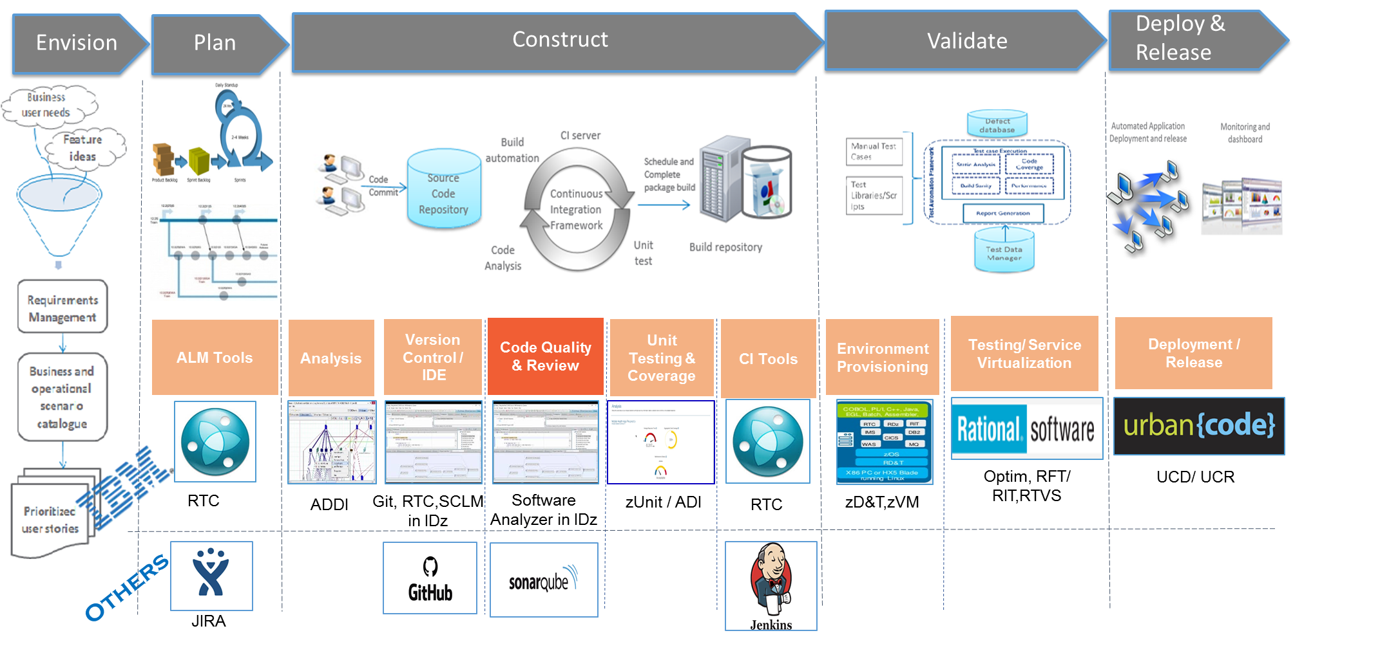
DEMO – 3 : SonarQube for Cobol

